Slide 1


CHAPTER 6
GRAPHS
§1 The Graph Abstract Data Type
1. Terminology
 G( V, E ) where G ::= graph, V = V( G ) ::= finite nonempty set of vertices, and E = E( G ) ::= finite set of edges.
 Undirected graph: ( v_{i} , v_{j} ) = ( v_{j} , v_{i} ) ::= the same edge.
 Directed graph (digraph): < v_{i} , v_{j} > ::= ≠ < v_{j} , v_{i} >
v_{i}
v_{j}
tail
head
 Restrictions :
(1) Self loop is illegal.
(2) Multigraph is not considered
0
1
0
1
2
 Complete graph: a graph that has the maximum number of edges
0
0
1
3
1
3
2
2

Slide 2
§1 The Graph ADT
 v_{i} and v_{j} are adjacent ;
( v_{i} , v_{j} ) is incident on v_{i} and v_{j}
v_{i}
v_{j}
 v_{i} is adjacent to v_{j} ; v_{j} is adjacent from v_{i} ;
< v_{i} , v_{j} > is incident on v_{i} and v_{j}
v_{i}
v_{j}
 Subgraph G’ ⊂ G ::= V( G’ ) ⊆ V( G ) && E( G’ ) ⊆ E( G )
 Path (⊂ G) from v_{p} to v_{q} ::= { v_{p}, v_{i1}, v_{i2}, ⋅⋅⋅, v_{in}, v_{q} } such that ( v_{p}, v_{i1} ), ( v_{i1}, v_{i2} ), ⋅⋅⋅, ( v_{in}, v_{q} ) or < v_{p}, v_{i1} >, ⋅⋅⋅, < v_{in}, v_{q} > belong to E( G )
 Length of a path ::= number of edges on the path
 Simple path ::= v_{i1}, v_{i2}, ⋅⋅⋅, v_{in} are distinct
 Cycle ::= simple path with v_{p} = v_{q}
 v_{i} and v_{j} in an undirected G are connected if there is a path from v_{i} to v_{j} (and hence there is also a path from v_{j} to v_{i})
 An undirected graph G is connected if every pair of distinct v_{i} and v_{j} are connected

Slide 3

§1 The Graph ADT
 (Connected) Component of an undirected G ::= the maximal connected subgraph
 A tree ::= a graph that is connected and acyclic
 Strongly connected directed graph G ::= for every pair of v_{i} and v_{j} in V( G ), there exist directed paths from v_{i} to v_{j} and from v_{j} to v_{i}
 Strongly connected component ::= the maximal subgraph that is strongly connected
 Degree( v ) ::= number of edges incident to v. For a directed G, we have in-degree and out-degree. For example:
v
in-degree(v) = 3; out-degree(v) = 1; degree(v) = 4
 Given G with n vertices and e edges, then

Slide 4

2. ADT
§1 The Graph ADT
structure Graph is
objects: A nonempty set of vertices and a set of undirected edges, where each edge is a pair of vertices.
functions: for all graph ∈ Graph, v, v₁, v₂ ∈ Vertices
Graph Create( ) ::= return an empty graph
Graph InsertVertex(graph, v)
::= return a graph with v inserted. v has no incident edges
Graph InsertEdge(graph, v₁, v₂)
::= return a graph with a new edge between v₁ and v₂
Graph DeleteVertex(graph, v)
::= return a graph in which v and all edges incident to it are removed
Graph DeleteEdge(graph, v₁, v₂)
::= return a graph in which the edge ( v₁, v₂ ) is removed. Leave the incident nodes in the graph
Boolean IsEmpty(graph)
::= if (graph == empty graph) return TRUE
else return FALSE
List Adjacent(graph, v)
::= return a list of all vertices that are adjacent to v
end Graph

Slide 5




§1 The Graph ADT
3. Graph Representations
Adjacency Matrix
adj_mat [ n ] [ n ] is defined for G(V, E) with n vertices, n ≥ 1 :
Hey you begin to know me!
Right. And it wastes time as well.
If we are to find out whether or not
G is connected, we’ll have to examine
all edges. In this case
T_{p} and S are both O( n² )
I know
what you’re about to say:
this representation wastes
space if the graph has a lot of
vertices but very few edges,
right?
The trick is to store the matrix as a 1-D array:
adj_mat [ n(n+1)/2 ] = { a₁₁, a₂₁, a₂₂, ..., a_{n1}, ..., a_{nn} }
The index for a_{ij} is ( i ∗ ( i − 1 ) / 2 + j ).
Note: If G is undirected, then adj_mat[ ][ ] is symmetric. Thus we can save space by storing only half of the matrix.

Slide 6
adj_mat[6][6]
0 1 2 3 4 5
B
C
0 0 0 0 0 0
0
1
2
3
4
5
0 0 0 0 0 0
A
D
0 0 0 0 0 0
0 0 0 0 0 0
F
E
0 0 0 0 0 0
0 0 0 0 0 0
An adjacency matrix representation of a undirected graph

Slide 7

§1 The Graph ADT
Adjacency Lists
Replace each row by a linked list
#define MAX_VERTICES 50 /* maximum number of vertices */
typedef struct node *node_ptr ;
typedef struct node {
int vertex ;
struct node *next ;
}
node_ptr graph [ MAX_VERTICES ] ;
int n = 0 ; /* vertices currently in use */
〖Example〗
0
1
2
graph[0]
graph[1]
graph[2]
Note: The order of nodes in each list does not matter.
1
0
•
•
For undirected G:
S = n heads + 2e nodes
= (n+2e) ptrs+2e ints
2
•

Slide 8
1
0
1
2
3
4
2 | ^
2
0
2
4 | ^
0
3
1 | ^
2
4 | ^
5
4
0 | ^
An adjacency list representation of a undirected graph

Slide 9
§1 The Graph ADT
A more compact way (without pointers) : node [ n + 2e + 1 ]
node[0] = n + 1; /* starting position of the list for vertex 0 */
node[1] = node[0] + e(0); /* starting position for vertex 1 */
… …
node[n−1] = node[n−2]+e(n−2); /* starting position for vertex n−1 */
node[n] = n + 2e + 1;
node[ node[0] ] to node[ node[1]−1 ] stores the vertices adjacent to vertex 0;
… …
node[ node[n−1] ] to node[ node[n]−1 ] stores the vertices adjacent to vertex n−1.
〖Example〗 Given n = 8, and e = 7.
0
4
node
[0]
[1]
[2]
[3]
[4]
[5]
[6]
[7]
[8]
1
2
5
9
11
13
15
17
18
20
22
23
3
6
7
node
[9]
[10]
[11]
[12]
[13]
[14]
[15]
[16]
[17]
[18]
[19]
[20]
[21]
[22]
1
2
0
3
0
3
1
2
5
4
6
5
7
6

Slide 10
§1 The Graph ADT
Degree( i ) = number of nodes in graph[ i ] (if G is undirected).
T_{p} of examine E(G) = O( n + e )
If G is directed, we need to find in-degree(v) as well.
Method 1 Add inverse adjacency lists.
〖Example〗
0
1
2
inv[0]
inv[1]
inv[2]
1
0
1
•
•
•
Method 2 Sparse matrix links for adj_mat[ i ] [ j ]
tail i
head j
•
•
row for tail
column for head

Slide 11
0
0
1
2
3
4
1
4 | ^
1
4
2 | ^
3 | ^
2
3
0
1 | ^
2 | ^
0
1
2
3
4
3 | ^
(a)
0
3 | ^
1
4 | ^
2 | ^
(b)
0 | ^
(a)An adjacency list representation of a directed graph
(b)An inverse adjacency list representation of a directed graph

Slide 12
§1 The Graph ADT
Adjacency Multilists
In adjacency list, for each ( i, j ) we have two nodes:
graph[i]
j
•
……
Now let’s combine the two nodes into one:
graph[j]
i
Wait a minute ...
Look at the space taken:
(n+2e) ptrs + 2e ints
and “mark” is not counted.
What’s the advantage?
•
……
graph[i]
node
graph[j]
mark
v₁
v₂
〖Example〗
graph[0]
0
1
•
•
•
•
0
graph[1]
Sometimes we need to
mark the edge after examine it,
and then find the next edge.
This representation makes
it easy to do so.
next
v₁
next
v₂
1
2
0
2
graph[2]
•
•
3
Weighted Edges
2
3
graph[3]
•
•
➢ adj_mat [ i ] [ j ] = weight
➢ adjacency lists \ multilists : add a weight field to the node.

Slide 13
§2 Elementary Graph Operations
Given an undirected graph G=( V, E ) and a vertex v ∈ V( G ). Visit all vertices in G that are reachable from (i.e., connected to ) v. (Assume adjacency list representation.)
1. Depth First Search ~ preorder traversal (stack)
#define FALSE 0
#define TRUE 1
short int visited [ MAX_VERTICES ] ;
void dfs ( int v )
{ /* depth first search of a graph beginning
with vertex v */
node_ptr w;
visited [ v ] = TRUE ;
printf ( “%5d”, v ) ;
for ( w = graph[ v ]; w; w = w->next )
if ( !visited[ w->vertex ] )
dfs ( w->vertex ) ;
}
dfs ( 0 )
0
1
2
3
4
5
6
T_{p} = O( e )
With adj_mat [ ][ ], T_{p} = O( n² ).

Slide 14
§2 Elementary graph Operations
2. Breadth First Search ~ level-order traversal (queue)
void bfs ( int v )
{ /* breadth first search of a graph
beginning with vertex v */
node_ptr w;
Queue Q;
Q = CreateQueue(); /* initialize queue */
printf ( “%5d”, v ) ;
visited [ v ] = TRUE ;
Enqueue (Q, v );
while ( !IsEmpty(Q) ) {
Dequeue ( Q , v) ;
for ( w = graph[ v ]; w; w = w->next )
if ( !visited[ w->vertex ] ) {
printf ( “%5d”, w->vertex ) ;
Enqueue ( Q , w->vertex );
visited [ w->vertex ] = TRUE ;
} /* end if */
} /* end while-loop */
}
bfs ( 0 )
0
1
2
3
4
5
6
T_{p} = O( e )
With adj_mat [ ][ ], T_{p} = O( n² ).

Slide 15
§2 Elementary graph Operations
3. Connected Components
(1) Is the graph connected?
➢ Call dfs(0) or bfs(0) —— O( e )
➢ Check if there is any vertices missing —— O( n )
T_{p} = O( n + e )
(2) List the connected components of G
void connected ( void )
{ /* determine the connected components of a graph */
int i ;
for ( i = 0; i < n; i++ )
if ( !visited[ i ] ) {
dfs ( i ) ; /* bfs can be used with no change in T_{p} */
printf ( “\n” );
} /* end if */
}
O( n )
O( e_{i1} + e_{i2} + ... ) = O( e )
T_{p} = O( n + e )

Slide 16
§2 Elementary graph Operations
4. Spanning Tree —— a tree which consists of V( G ) and a subset of E( G )
〖Example〗 A complete graph and three of its spanning trees
【Remarks】
① E( G ) = T + N where T is for tree edges and N for non-tree edges.
② T consists of the edges traversed by the search program. We can add a piece of code to collect these edges into a linked list T.

Slide 17
§2 Elementary graph Operations
【Remarks】
0
1
0
1
③ dfs and bfs give different spanning trees.
④ Adding an edge in N to a spanning tree, we obtain a cycle.
2
3
2
3
⑤ If we introduce the edges in N into the spanning tree one at a time, then we obtain a cycle basis —— that is, all the cycles are independent, and all other cycles in G can be constructed as a linear combination of the cycles in the basis.
⑥ A spanning tree is a minimal subgraph. That is, G’ ⊂ G such that V( G’ ) = V( G ), G’ is connected, and E( G’ ) is minimal.
 G is connected ⇒ e ≥ n − 1,
and G is connected and e = n − 1 ⇒ G is a tree.
∴ e = n − 1 for a spanning tree.

Slide 18
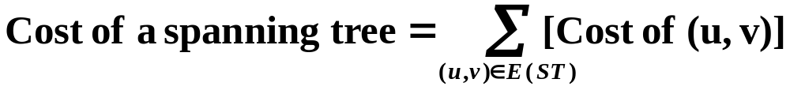

§3 Minimum Cost Spanning Trees
Greedy Method
Make the best decision for each stage, under the following constrains :
(1) we must use only edges within the graph
(2) we must use exactly n−1 edges
(3) we may not use edges that would produce a cycle.
Kruskal’s Algorithm
T = { } ;
while (T contains less than n−1 edges && E is not empty) {
choose a least cost edge (v, w) from E ;
delete (v, w) from E ;
if ((v, w) does not create a cycle in T) add (v, w) to T ;
else discard (v, w) ;
}
if (T contains fewer than n−1 edges)
printf ( “No spanning tree\n” ) ;

Slide 19
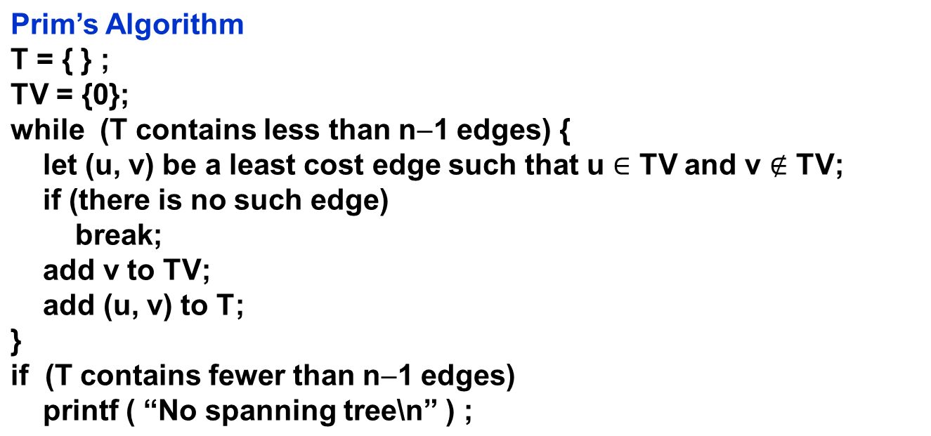

Slide 20
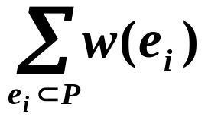

§4 Shortest Paths and Transitive Closure
Given a digraph G = ( V, E ), and a weighting function w( e ) > 0 for e ∈ E( G ). The length of a path P from source to destination is
1. Single Source All Destinations
Given a source v₀. Determine a shortest path to each v ∈V(G) \ { v₀ }.
45
Path
Length
non-decreasing
50
10
v₀
v₁
v₄
1) v0 v2
10
2) v0 v2 v3
25
20
10
15
35
3) v0 v2 v3 v1
45
20
30
4) v0 v4
45
v₂
15
v₃
3
v₅
Note: A path with minimal number of vertices is NOT necessarily the shortest.

Slide 21
§4 Shortest Paths & Transitive Closure
Let S = { v₀ and v_{i}’s whose shortest paths have been found }
For any u ∉ S, define distance [ u ] = minimal length of path { v₀ → ( v_{i} ∈ S ) → u }. If the paths are generated in non-decreasing order, then
① the shortest path must go through ONLY v_{i} ∈ S ;
② u is chosen so that distance[ u ] = min{ w∉S | distance[ w ] } (If u is not unique, then we may select any of them) ;
Why? If it is not true, then
there must be a vertex w on this path
that is not in S. Then ...
③ if distance [ u₁ ] < distance [ u₂ ] and we add u₁ into S, then distance [ u₂ ] may change. If so, a shorter path from v₀ to u₂ must go through u₁ and distance’ [ u₂ ] = distance [ u₁ ] + length(< u₁, u₂>).
Implementation
Note:
LARGE_NO must be greater than max{w(e_{i})}, and max{distance[i]} +
LARGE_NO won’t overflow.
{ v_{i} } = { 0, 1, ..., n−1 }

Slide 22
§4 Shortest Paths & Transitive Closure
void shortestpath ( int v, int cost [ ] [ MAX_VERTICES ],
int distance [ ], int n, short int found [ ] )
{ int i, u, w ;
for ( i = 0; i < n; i++ ) { /* initialization */
found [ i ] = FALSE ;
distance [ i ] = cost [ v ] [ i ] ;
} /* end for-loop */
found [ v ] = TRUE ;
distance [ v ] = 0 ;
for ( i = 0; i < n−2; i++ ) {
u = choose ( distance, n, found ) ; /* O( n ) */
/* find the min distance not yet checked. Program 6.10 on p.303 */
found [ u ] = TRUE ;
for ( w = 0; w < n; w++ )
if ( !found [ w ] )
if ( distance [ u ] + cost [ u ] [ w ] < distance [ w ] )
/* if adding u into S makes distance[w] shorter */
distance [ w ] = distance [ u ] + cost [ u ] [ w ] ;
} /* end for-loop */
}
T_{p} = O( n² )

Slide 23


§5 Activity Networks
1. Activity On Vertex ( AOV ) Networks
〖Example〗 Courses needed for a computer science degree at a hypothetical university
How shall we convert this list
into a graph?

Slide 24
§5 Activity Networks
 AOV Network ::= digraph G in which V( G ) represents activities ( e.g. the courses ) and E( G ) represents precedence relations ( e.g. means that C1 is a prerequisite course of C3 ).
C1
C3
 i is a predecessor of j ::= there is a path from i to j
i is an immediate predecessor of j ::= < i, j > ∈ E( G )
Then j is called a successor ( immediate successor ) of i
 Partial order ::= a precedence relation which is both transitive ( i → k, k → j ⇒ i → j ) and irreflexive ( i → i is impossible ).
Note: If the precedence relation is reflexive, then there must be an i such that i is a predecessor of i. That is, i must be done before i is started. Therefore if a project is feasible, it must be irreflexive.
Feasible AOV network must be a dag (directed acyclic graph).

Slide 25
§5 Activity Networks
【Definition】A topological order is a linear ordering of the vertices of a graph such that, for any two vertices, i, j, if i is a predecessor of j in the network then i precedes j in the linear ordering.
Note: The topological orders may not be unique for a network. For example, there are several ways (topological orders) to meet the degree requirements in computer science.
Goal
Test an AOV for feasibility, and generate a topological order if possible.
Algorithm
for ( i = 0; i < n; i++ ) {
if every vertex has a predecessor {
fprintf(stderr, “Network has a cycle.\n” );
exit( 1 ) ; }
pick a vertex v that has no predecessors ;
output v ;
delete v and all edges leading out of v from the network ;
}

Slide 26
§5 Activity Networks
2. AOE ( Activity On Edge ) Networks
—— scheduling a project
a_{i} ::= activity
Signals the completion of a_{i}
v_{j}
 early( i ) \ late( i ) ::= the earliest \ latest start time for the activity a_{i}
 earliest[ j ] \ latest[ j ] ::= the earliest \ latest time the event v_{j} can occur
Techniques
A CPM notation:
 PERT ( Performance Evaluation & Review Technique )
Index of vertex
Earliest
Start Time
 CPM ( Critical Path Method )
Lasting Time
 RAMPS ( Resource Allocation & Multiproject Scheduling )
Slack Time
Latest
Start Time

Slide 27
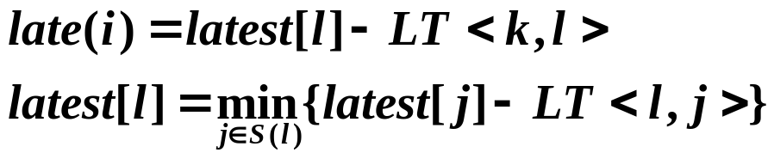
§5 Activity Networks
〖Example〗 AOE network of a hypothetical project
6
16
a0=6
1
a3=1
6
0
6
a6=9
16
a9=2
start
0
7
0
4
a1=4
7
8
18
2
a7=7
a10=4
finish
4
a4=1
14
18
2
2
7
6
14
a2=5
a11=0
a8=4
5
7
3
3
a5=2
5
5
7
Dummy activity
➢ Calculation of EST: Start from v0, for any a_{i} = <k, i>, we have
➢ Calculation of LST: Start from the last vertex v8, for any a_{i} = <k, l>, we have
Immediate predecessors of k
➢ Slack Time of <i, j> =
➢ Critical Path ::= { v_{i} | earliest [ i ] = latest [ i ] }
Critical Activity ::= {a_{i} | early ( i ) = late ( i ) }
Implementation:
Modify topsort

Slide 28
Biconnected graph
Articulation point: 连通图里删除这个顶点后会得到至少两个连通分量。
Biconnected graph：没有Articulation point的连通图
Biconnected component
Find the articulation point

Slide 29
Homework
P. 277 2
P. 291 1
P312 4
P328 1, 2

